Slide 1

Kevin Boyd & Scott Frazier

Slide 2
Breweries Per State

Slide 3
Missing Values

Slide 4
Median ABV and IBU by State

Slide 5
Highest ABV and IBU

Slide 6
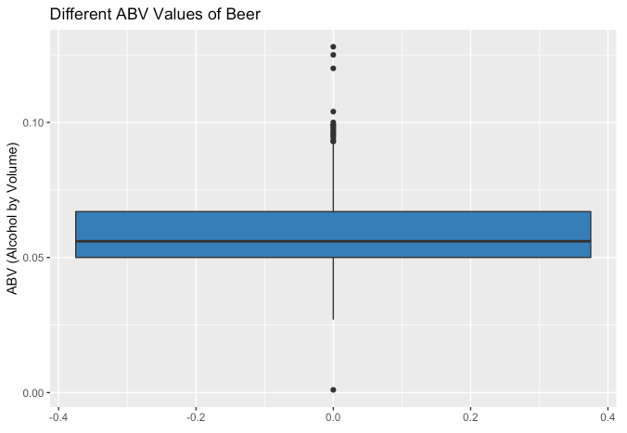
ABV Distribution
Mean: 0.05977
Median: 0.056

Slide 7
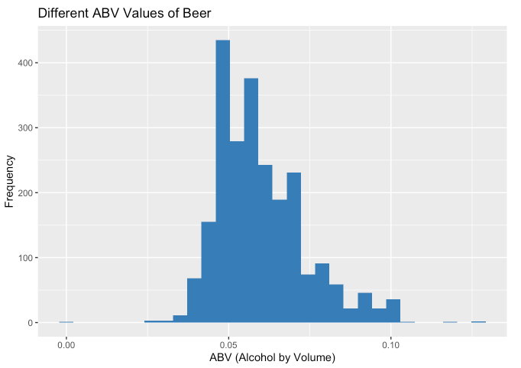
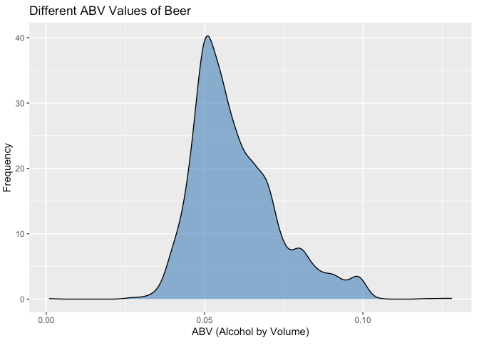
ABV Distribution

Slide 8
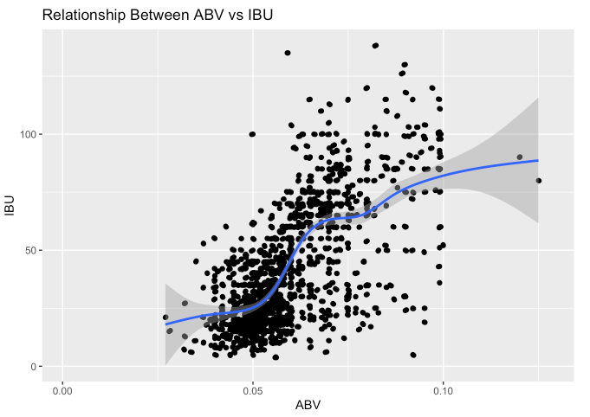
Relationship Between ABV and IBU

